Slide 1
Angular
Author: Giau Le

Slide 2
Agenda
Angular Introduction
Overview
Spring Data Flow Chart
Set up Environment
Explore Angular project
Component
NgModules
TypeScript
Angular Data Binding

Slide 3
Agenda
Directives
Pipes
Component Investigation: Lifecycle, Interaction
Template reference variables
Forms
Reactive forms
Template-driven forms
Dependency injection
Promise (Js)
Http Client
Routing & Navigation
Observables (Optional)

Slide 4
References
https://angular.io/docs
https://viettuts.vn/angular7
https://xuanthulab.net/tao-va-su-dung-module-trong-angular.html

Slide 5
Angular Introduction
A application design framework and development platform creating efficient and sophisticated single-page apps.
Combines declarative templates, dependency injection, end to end tooling, and integrated best practices to solve development challenges.
“A single-page application (SPA) is a web application or website that interacts with the web browser by dynamically rewriting the current web page with new data from the web server, instead of the default method of the browser loading entire new pages.”

Slide 6
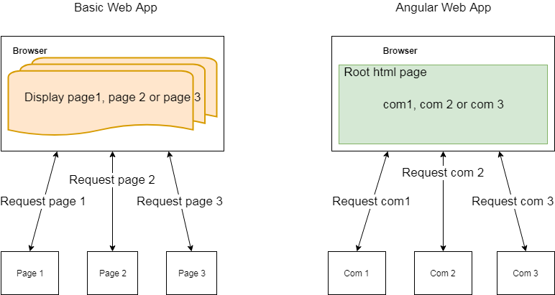
Angular Introduction

Slide 7
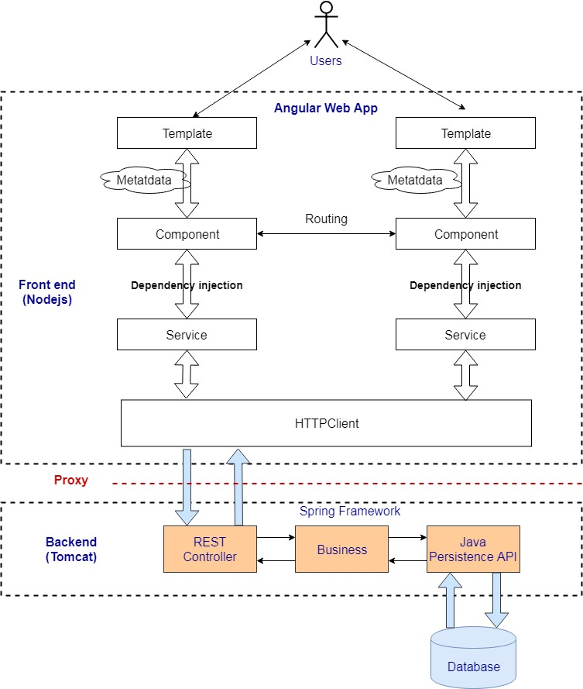
Angular Webapp Flow Example

Slide 8
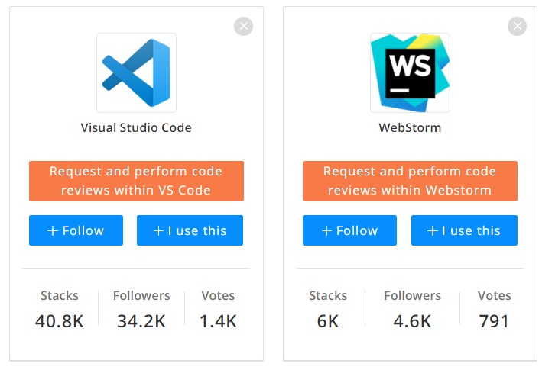
Set up Environment
IDE

Slide 9
Set up Environment
https://code.visualstudio.com/
https://code.visualstudio.com/docs/nodejs/angular-tutorial
Extention:
Angular Language Service, EditorConfig for VS Code, ESLint/TSLint, Nx Console (optional)

Slide 10
Set up Environment
Install
Node.js npm
https://nodejs.org/en/download/
b. Angular CLI
npm install -g @angular/cli
-You can check the version:
node –v
npm –v
More details: https://angular.io/guide/quickstart

Slide 11
Set up Environment
2. Intro to Yarn
https://yarnpkg.com/
https://viblo.asia/p/yarn-mot-cai-tien-dang-ke-so-voi-npm-yMnKMqRQK7P

Slide 12
Explore Angular project
Create new angular project
-Open cmd and point to folder
ng new my-app
-Go to the project directory and launch the server.
cd my-app (go to folder project)
ng serve –open
OR ng serve --port=other-port. Ex: ng serve --port=9000
- The ng serve command launches the server, watches your files, and rebuilds the app as you make changes to those files.
-Open your browser on http://localhost:4200/

Slide 13
Explore Angular project
Project file structure
https://angular.io/guide/file-structure
Behind the scense
https://medium.com/siam-vit/how-an-angular-app-work-behind-the-scenes-angular-flow-dcc4d1df27bd
Angular CLI – generate
https://angular.io/cli/generate
Ex: ng generate module

Slide 14
Explore Angular project
NgModules
https://angular.io/guide/architecture-modules
NgModules configure the injector and the compiler and help organize related things together.
An NgModule is a class marked by the @NgModule decorator.

Slide 15
Explore Angular project
NgModule metadata does the following:
Declares which components, directives, and pipes belong to the module.
Makes some of those components, directives, and pipes public so that other module's component templates can use them.
Imports other modules with the components, directives, and pipes that components in the current module need.
Provides services that the other application components can use.
An NgModule can only export the declarable classes it owns or imports from other modules. It doesn't declare or export any other kind of class.

Slide 16
Explore Angular project
NgModule metadata
declarations—this application's component.
imports—import BrowserModule to have browser specific services such as DOM rendering, sanitization, and location.
providers—the service providers.
bootstrap—the root component that Angular creates and inserts into the index.html host web page. Launching your app with a root module
Every application has at least one Angular module, the root module, which must be present for bootstrapping the application on launch.

Slide 17
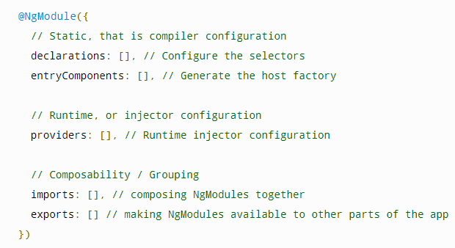
Explore Angular project

Slide 18
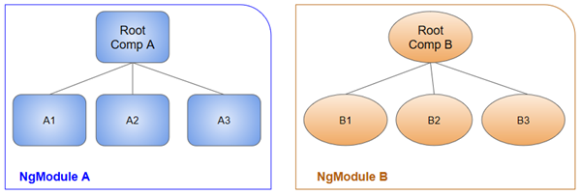
Explore Angular project

Slide 19
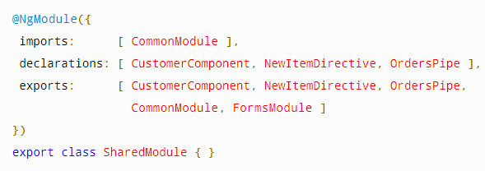
Explore Angular project
Sharing modules
You can put commonly used directives, pipes, and components into one module and
Import that module wherever you need it in other parts of your app.
It imports the CommonModule because the module's component needs common directives.
It declares and exports the utility pipe, directive, and component classes.
It re-exports the CommonModule and FormsModule.

Slide 20
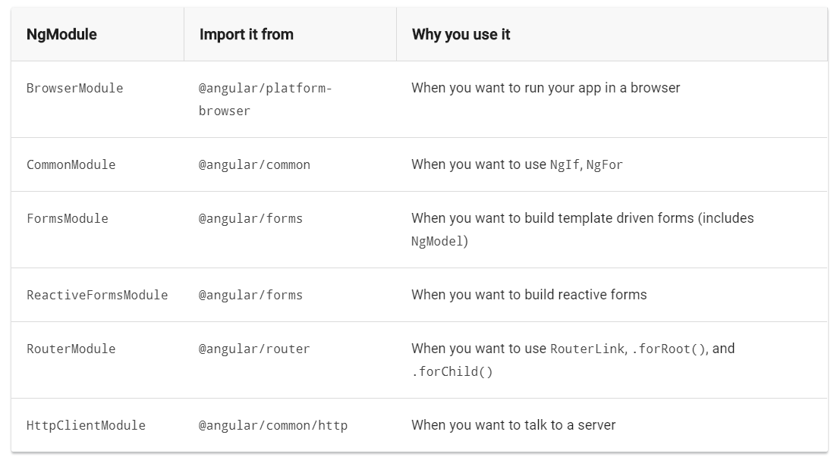
Explore Angular project
Frequently-used modules

Slide 21
Explore Angular project
Entry components
An entry component is any component that Angular loads imperatively, (which means you’re not referencing it in the template), by type. You specify an entry component by bootstrapping it in an NgModule, or including it in a routing definition.
There are two main kinds of entry components:
The bootstrapped root component.
A component you specify in a route definition.

Slide 22
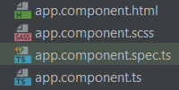
Explore Angular project
Components
https://angular.io/guide/architecture-components
Angular CLI: ng generate component hero
Angular components form the data structure of your application.
The HTML template associated with a component provides the means to display that data in the context of a web page.

Slide 23
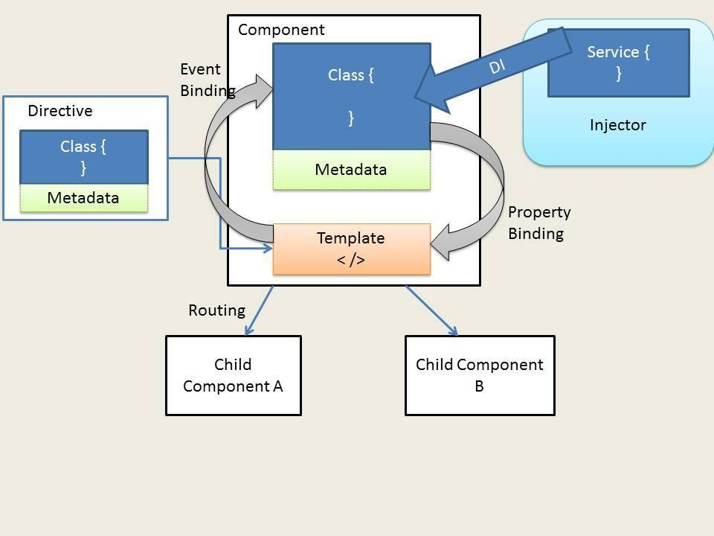
Explore Angular project

Slide 24
Explore Angular project
Syntax
import { Component} from '@angular/core';
@Component({
selector: 'app-home',
templateUrl: './home.html'
})
export class HomeComponent {
constructor() {
}
}
<app-home></app-home>

Slide 25
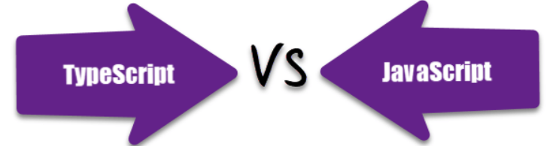
TypeScript
JavaScript is a scripting language which helps you create interactive web pages whereas Typescript is a superset of JavaScript.
TypeScript being a superset of JavaScript
Typescript code needs to be compiled while JavaScript code doesn’t need to compile.
Typescript supports a feature of prototyping while JavaScript doesn't support this feature.
Typescript uses concepts like types and interfaces to describe data being used whereas JavaScript has no such concept.
Typescript is a powerful type system, including generics & JS features for large size project whereas JavaScript is an ideal option for small size project.

Slide 26
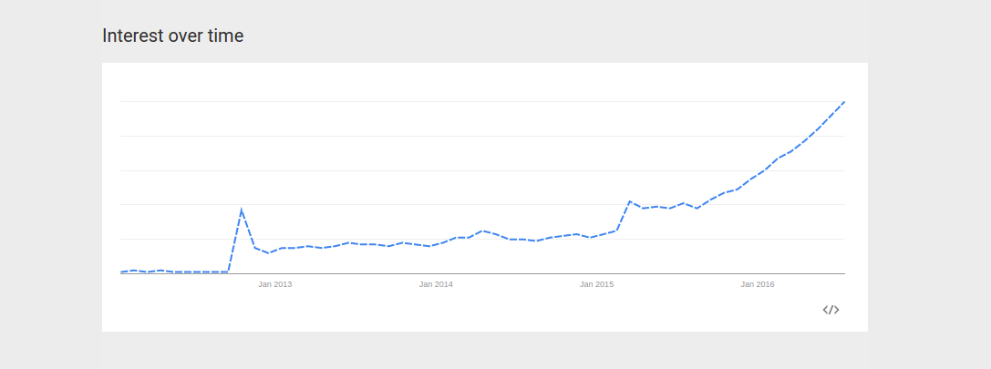
TypeScript

Slide 27
TypeScript
https://www.typescriptlang.org/docs/handbook/typescript-in-5-minutes.html
Basic Types
Boolean
Number
String
Array
Tuple
Enum
Any
Void
Null and Undefined
Object

Slide 28
TypeScript
Variable Declarations
let and const are two relatively new types of variable declarations in JavaScript.
let color: string = "blue";
let list: number[] = [1, 2, 3];
const numLivesForCat = 9;

Slide 29
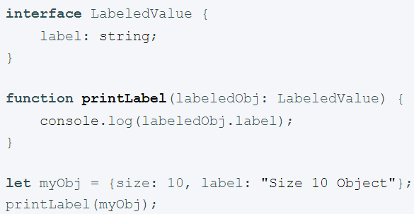
TypeScript
Interface
Interfaces fill the role of naming these types, and are a powerful way of defining contracts within your code as well as contracts with code outside of your project.

Slide 30
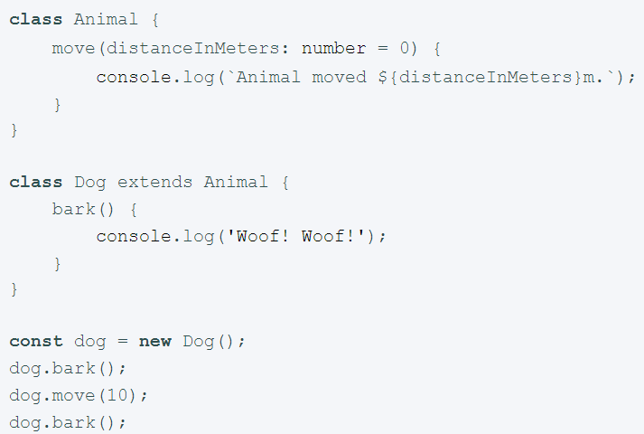
TypeScript
Class
The syntax should look familiar if you’ve used C# or Java before.
we can use common object-oriented patterns. One of the most fundamental patterns in class-based programming is being able to extend existing classes to create new ones using inheritance.
Public by default

Slide 31
Angular Data Binding
Ref
https://angular.io/guide/binding-syntax
https://angular.io/guide/property-binding
https://angular.io/guide/event-binding
https://angular.io/guide/two-way-binding

Slide 32
Angular Data Binding
Data-binding is a mechanism for coordinating what users see, specifically with application data values.
Source-to-view
View-to-source
View-to-source-to-view
Interpolation ( {﻿{...}} ):
<p>My current hero is {{currentHero.name}}</p>

Slide 33
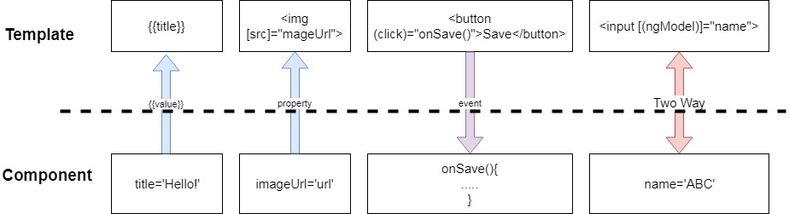
Angular Data Binding
Data Binding Type

Slide 34
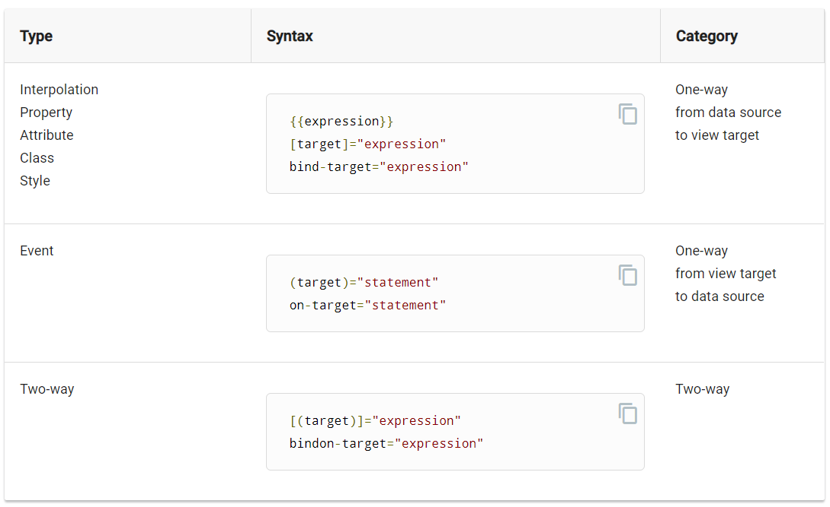
Angular Data Binding

Slide 35
Angular Data Binding
The brackets, [], tell Angular to evaluate the template expression. If you omit the brackets, Angular treats the string as a constant and initializes the target property with that string
<app-item-detail childItem="parentItem"></app-item-detail>

Slide 36
Angular Data Binding
Property Binding
<img [src]="itemImageUrl">
itemImageUrl = '../assets/phone.png';

Slide 37
Angular Data Binding
Attribute, class, and style bindings
<tr><td [attr.colspan]="1 + 1">One-Two</td></tr>
<div class="myClass" [class]="myClassBinding">Setting all classes with binding</div>
<h1 [class.myClass]="isTrue">This class binding is for true value</h1>
<h1 [style.color]="blue">This is a Blue Heading</h1>

Slide 38
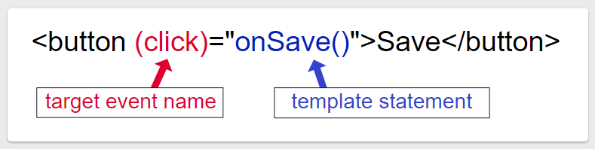
Angular Data Binding
Event Binding
Ref to DOM event object
https://developer.mozilla.org/en-US/docs/Web/Events

Slide 39
Angular Data Binding
Event Binding
User actions such as clicking a link, pushing a button, and entering text raise DOM events.
Binding to these events provides a way to get input from the user.
<button (click)="onClickMe()">Click me!</button>
Get user input from the $event object
template: ` <input (keyup)="onKey($event)"> <p>{{values}}</p>`
When a user presses and releases a key, the keyup event occurs, and Angular provides a corresponding DOM event object in the $event variable which this code passes as a parameter to the component's onKey() method.

Slide 40
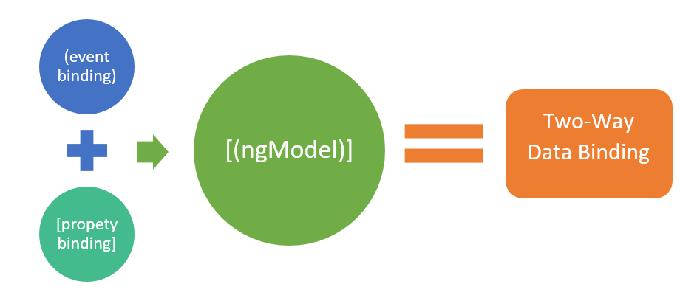
Angular Data Binding
Two-way binding
Two-way binding gives your app a way to share data between a component class and its template.

Slide 41
Angular Data Binding
The NgModel directive allows you to display a data property and update that property when the user makes changes
<input [(ngModel)] ="myMsg"/>
Before using the ngModel directive in a two-way data binding, you must import the FormsModule and add it to the NgModule's imports list

Slide 42
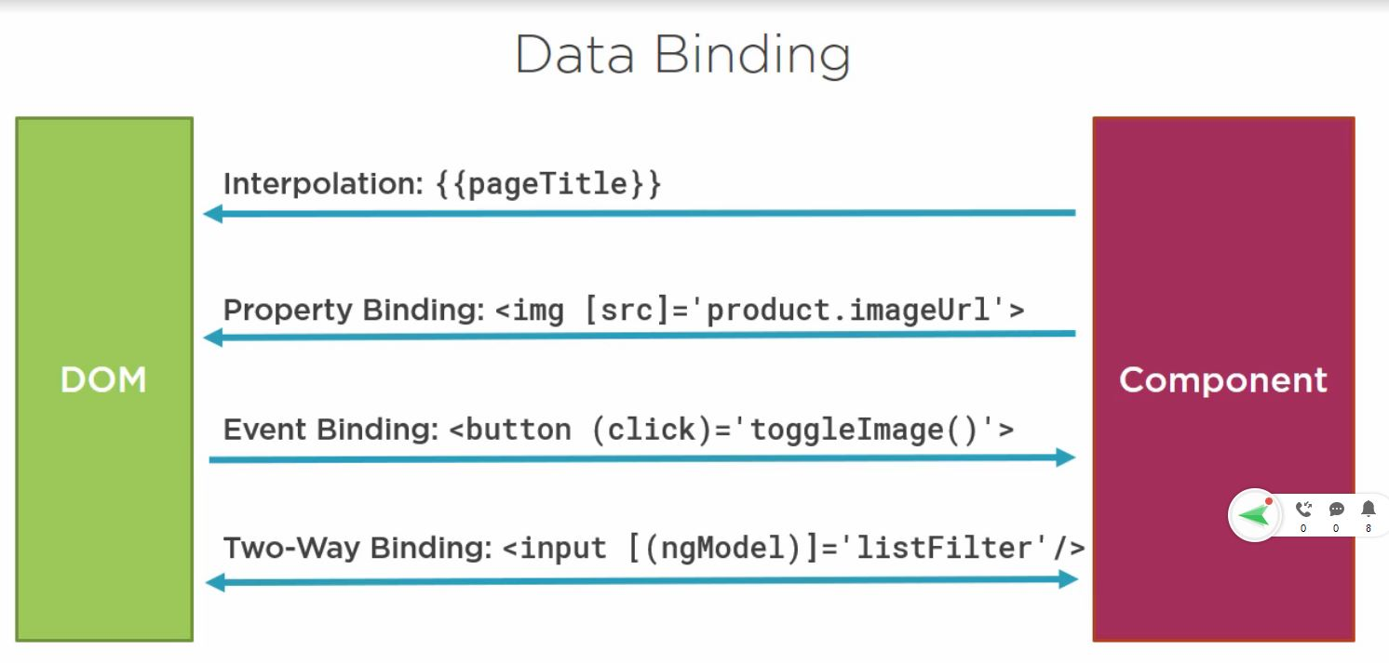

Slide 43
Template reference variables
https://angular.io/guide/template-reference-variables
Get user input from a template reference variable
<input #box (keyup)="0"> <p>{{box.value}}</p>

Slide 44
Component Investigation

Slide 45
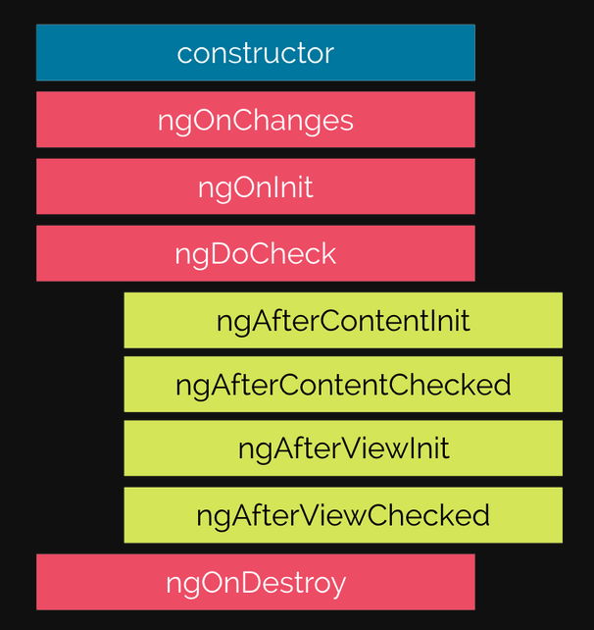
Component lifecycle
https://viblo.asia/p/lifecycle-hooks-trong-angular-6J3Zgw8qZmB

Slide 46
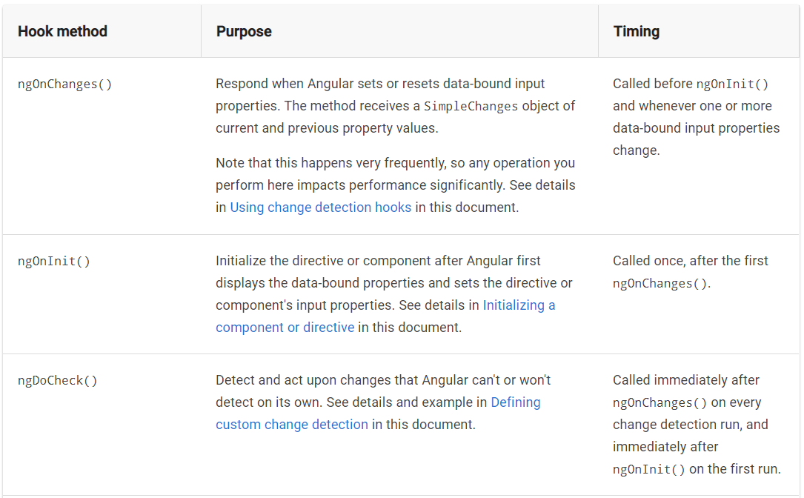
Component lifecycle

Slide 47
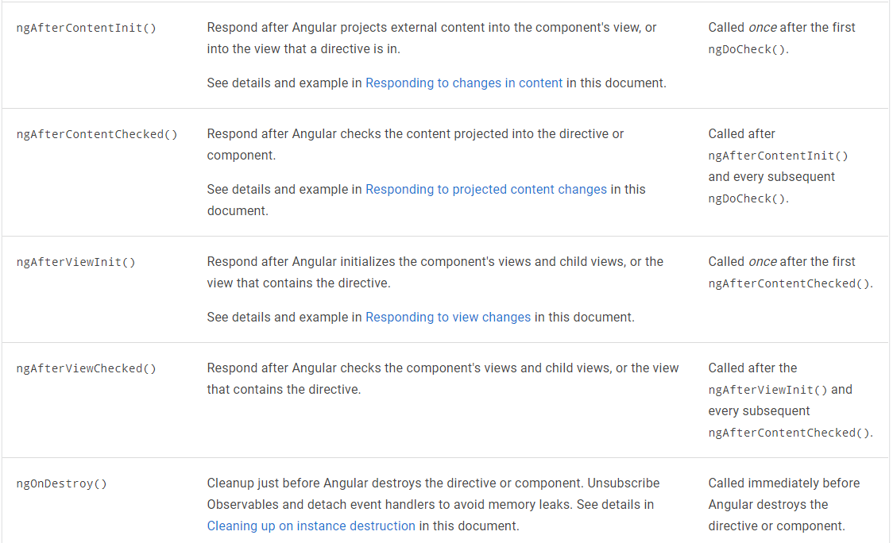
Component lifecycle

Slide 48
Component interaction
Data from parent to child with input binding
@Input decorations.
Intercept input property changes with a setter
@Input() set name(name: string)
{ this._name = (name && name.trim()) || '<no name set>'; }
Intercept input property changes with ngOnChanges()
ngOnChanges(changes: {[propKey: string]: SimpleChange}) {

Slide 49
Component interaction
Parent listens for child event
The child component exposes an EventEmitter property with which it emits events when something happens
The child's EventEmitter property is an output property
@Output() voted = new EventEmitter<boolean>();
Parent interacts with child via local variable
A parent component cannot use data binding to read child properties or invoke child methods.
Creating a template reference variable for the child element and then reference that variable within the parent template.

Slide 50
Component interaction
Parent calls an @ViewChild()
inject the child component into the parent as a ViewChild.
@ViewChild
Parent and children communicate via a service ...

Slide 51
Component interaction
Input and Output properties
Syntax
@Input() hero: Hero;
@Output() deleteRequest = new EventEmitter<Hero>();
<hero-detail [hero]="currentHero" (deleteRequest)="deleteHero($event)"></hero-detail>
Example

Slide 52
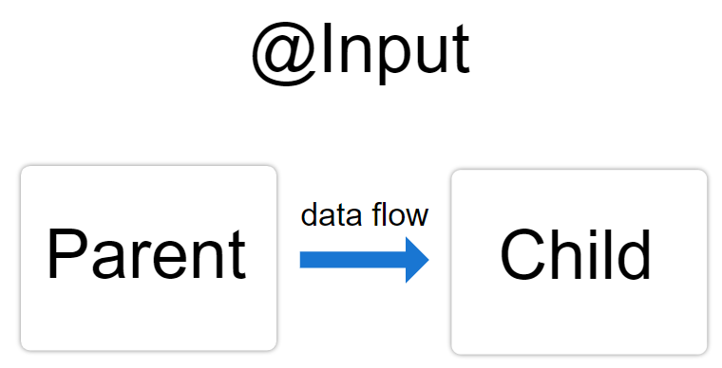
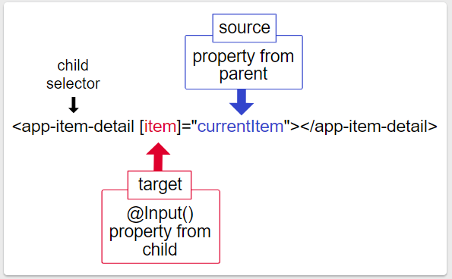
Component interaction

Slide 53
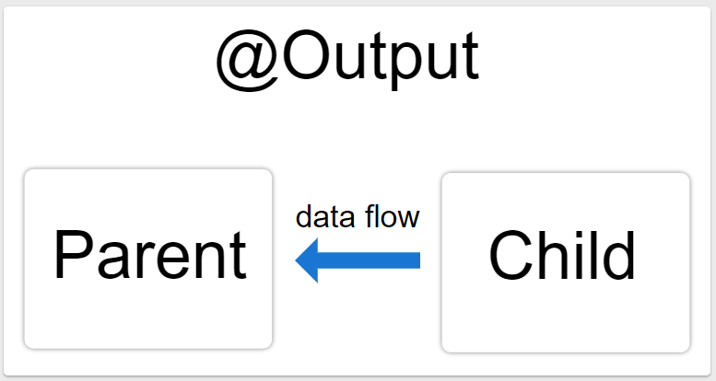
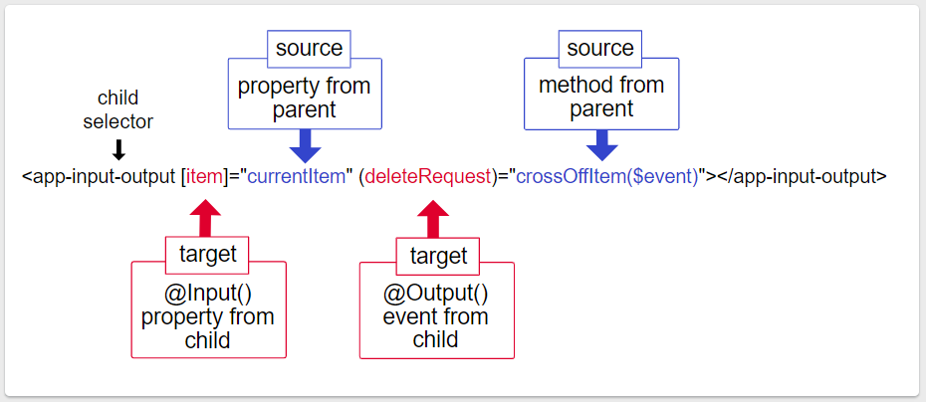
Component interaction

Slide 54
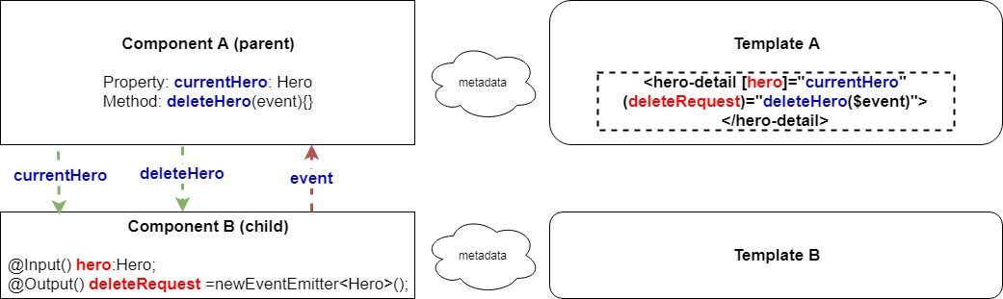
Component interaction
Input and Output properties example

Slide 55
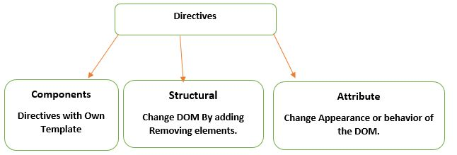
Directives

Slide 56
Directives
Built-in structural directives
NgIf:
<app-hero-detail *ngIf="isActive"></app-hero-detail>
NgSwitch
NgForOf:
<div *ngFor="let hero of heroes">{{hero.name}}</div>
Built-in attribute directives
NgClass—adds and removes a set of CSS classes.
NgStyle—adds and removes a set of HTML styles.
NgModel—adds two-way data binding to an HTML form element.

Slide 57
Attribute directives
Used as attributes of elements.
For example, can change several element styles at the same time.
An attribute directive minimally requires building a controller class annotated with @Directive, which specifies the selector that identifies the attribute.
Directives must be declared in Angular Modules in the same manner as components.

Slide 58
Attribute directives
Angular CLI:
ng generate directive highlight
Directives must be declared in Angular Modules in the same manner as components.
Implement
Apply the attribute directive

Slide 59
Attribute directives
Build a simple attribute directive demo (with Respond to user-initiated events):
Ex: mouseover, mouse
@HostListener decorator lets you subscribe to events of the DOM element
Pass values into the directive with an @Input data binding
@Input() highlightColor: string;

Slide 60
Structural directives
Be Responsible for HTML layout.
They shape or reshape the DOM's structure, typically by adding, removing, or manipulating elements.
Three of the common, built-in structural directives—NgIf, NgFor, and NgSwitch.
Note: A directive could hide the unwanted paragraph instead by setting its display style to none.

Slide 61
Structural directives
Write a structural directive
Import the Directive decorator (instead of the Component decorator).
Import the Input, TemplateRef, and ViewContainerRef symbols; you'll need them for any structural directive.
Apply the decorator to the directive class.
Set the CSS attribute selector that identifies the directive when applied to an element in a template.

Slide 62
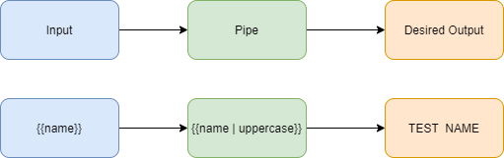
Pipes
A way to write display-value transformations that you can declare in your HTML
A pipe takes in data as input and transforms it to a desired output.

Slide 63
Pipes
Built-in pipes
DatePipe, UpperCasePipe, LowerCasePipe, CurrencyPipe, and PercentPipe
Ex: <p>The hero's birthday is {{ birthday | date:"MM/dd/yy" }} </p>
Chaining pipes
You can chain pipes together in potentially useful combinations.
{{ birthday | date | uppercase}}

Slide 64
Pipes
Custom pipes
A pipe is a class decorated with pipe metadata.
The pipe class implements the PipeTransform interface's transform.
There will be one additional argument to the transform method for each parameter passed to the pipe.
To tell Angular that this is a pipe, you apply the @Pipe decorator
The @Pipe decorator allows you to define the pipe name that you'll use within template expressions.

Slide 65
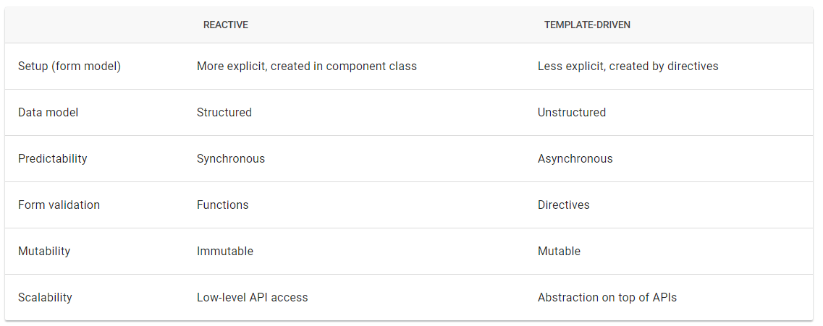
Forms
Angular provides two different approaches to handling user input through forms: reactive and template-driven.

Slide 66
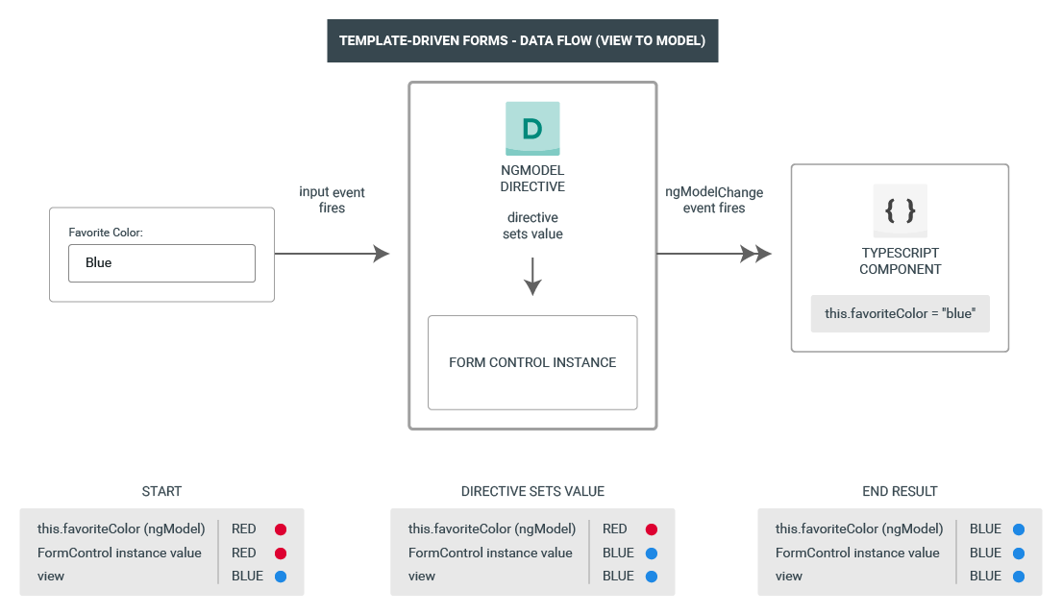
Template-driven forms
Template-driven forms use two-way data binding to update the data model in the component as changes are made in the template and vice versa.

Slide 67
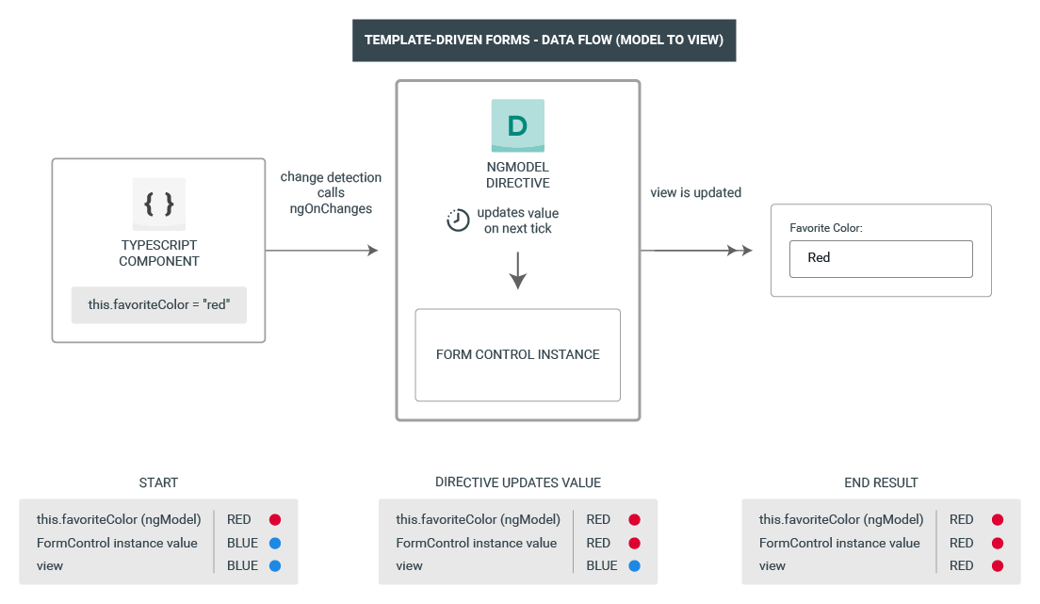
Template-driven forms

Slide 68
Template-driven forms
Build the basic form.
Define a sample data model.
Include FormsModule.
Bind form controls to data properties using the ngModel directive and two-way data-binding syntax.
Examine how ngModel reports control states using CSS classes.
Name controls to make them accessible to ngModel.
Validity and control status using ngModel.
Track input Add custom CSS to provide visual feedback on the status.
Show and hide validation-error messages.

Slide 69
Template-driven forms
Respond to a native HTML button-click event by adding to the model data.
Handle form submission using the [ngSubmit(api/forms/NgForm#properties)] output property of the form.
Disable the Submit button until the form is valid.

Slide 70
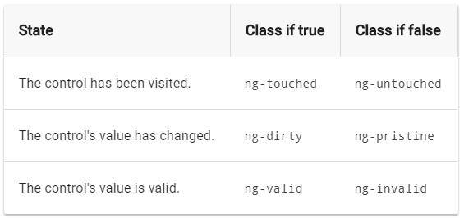
Template-driven forms
import { FormsModule } from '@angular/forms';
Two-way data binding with ngModel
<input type="text" class="form-control" id="name" required [(ngModel)]="model.name" name="name">
Track control state and validity with ngModel

Slide 71
Template-driven forms
Show and hide validation error messages
<div [hidden]="name.valid || name.pristine" class="alert alert-danger"> Name is required </div>
Submit the form with ngSubmit
<form (ngSubmit)="onSubmit()" #heroForm="ngForm">
<button type="submit" class="btn btn-success" [disabled]="!heroForm.form.valid">Submit</button>

Slide 72
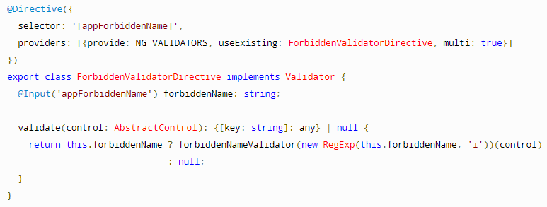
Template-driven forms
Validating form input
Built-in validator directives
<input id="name" name="name" class="form-control" required minlength="4" [(ngModel)]="hero.name" #name="ngModel" >
Custom validators
Defining custom validators
Adding custom validators
<input id="name" name="name" class="form-control" appForbiddenName="bob" [(ngModel)]="hero.name" #name="ngModel" >Display form status
Form Status: {{ profileForm.status }}

Slide 73
Template-driven forms
required: Yêu cầu form control không được phép bỏ trống.
minlength: Yêu cầu form control phải có value có length ít nhất bằng một giá trị nào đó.
maxlength: Yêu cầu form control phải có value có length không vượt quá một giá trị nào đó.
pattern: Yêu cầu form control phải có value thỏa mãn một pattern nào đó (RegEx).
email: Yêu cầu form control phải có value thỏa mãn pattern của một email

Slide 74
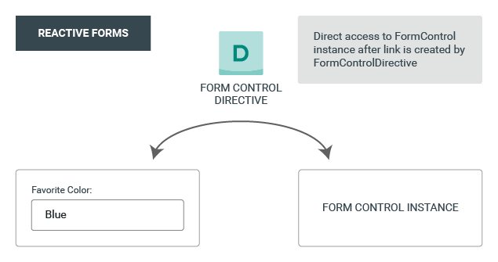
Reactive form
Model-driven approach to handling form inputs

Slide 75

Reactive form
Three steps to using form controls
Register the reactive forms module in your app.
Generate a new FormControl instance and save it in the component.
Register the FormControl in the template.
Displaying a form control value
Through the valueChanges observable where you can listen for changes in the form's value in the template.
With the value property, which gives you a snapshot of the current value.

Slide 76
Reactive form
Grouping form controls
A form group defines a form with a fixed set of controls that you can manage together.
A form array defines a dynamic form, where you can add and remove controls at run time.
Steps
Create a FormGroup instance.
Associate the FormGroup model and view.
Save the form data.

Slide 77
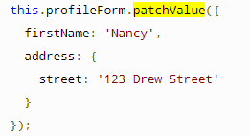
Reactive form
Updating parts of the data model
Use the setValue() method to set a new value for an individual control.
this.name.setValue('Nancy');
Use the patchValue() method to replace any properties defined in the object that have changed in the form model.
Using the FormBuilder service to generate controls
Import the FormBuilder class.
Inject the FormBuilder service.
Generate the form contents.

Slide 78
Reactive form
Validating input in reactive forms
Sync validators: Synchronous functions that take a control instance and immediately return either a set of validation errors or null. You can pass these in as the second argument when you instantiate a FormControl.
Async validators: Asynchronous functions that take a control instance and return a Promise or Observable that later emits a set of validation errors or null. You can pass these in as the third argument when you instantiate a FormControl.
isUserNameDuplicated(control: AbstractControl): Observable<ValidationErrors> { return of(null); }
let control = new FormControl("", Validators.required, this.isUserNameDuplicated);
this.fb.control("", Validators.required, this.isUserNameDuplicated);

Slide 79
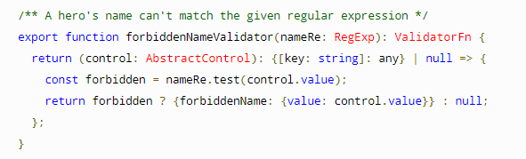
Reactive form
Validating form input
Built-in validator functions
Custom validators
Defining custom validators
Adding custom validators
name: new FormControl(
this.hero.name, [forbiddenNameValidator(/bob/i)])
Form Status: {{ profileForm.status }}
let control = new FormControl("", Validators.required);
//Or this.fb.control("", Validators.required);

Slide 80
Dependency injection
Dependency injection (DI), is an important application design pattern. Angular has its own DI framework, which is typically used in the design of Angular applications to increase their efficiency and modularity.
Dependencies are services or objects that a class needs to perform its function.
DI is a coding pattern in which a class asks for dependencies from external sources rather than creating them itself.

Slide 81
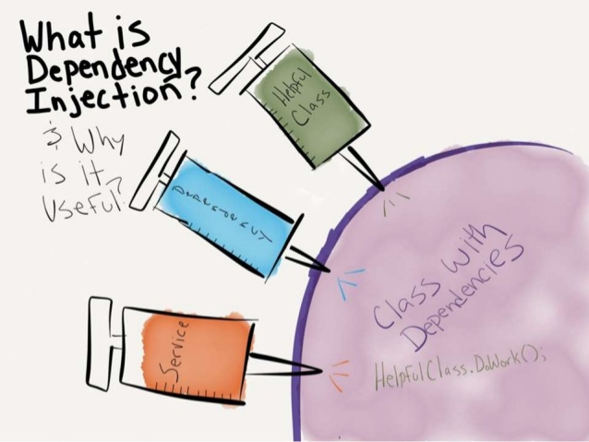
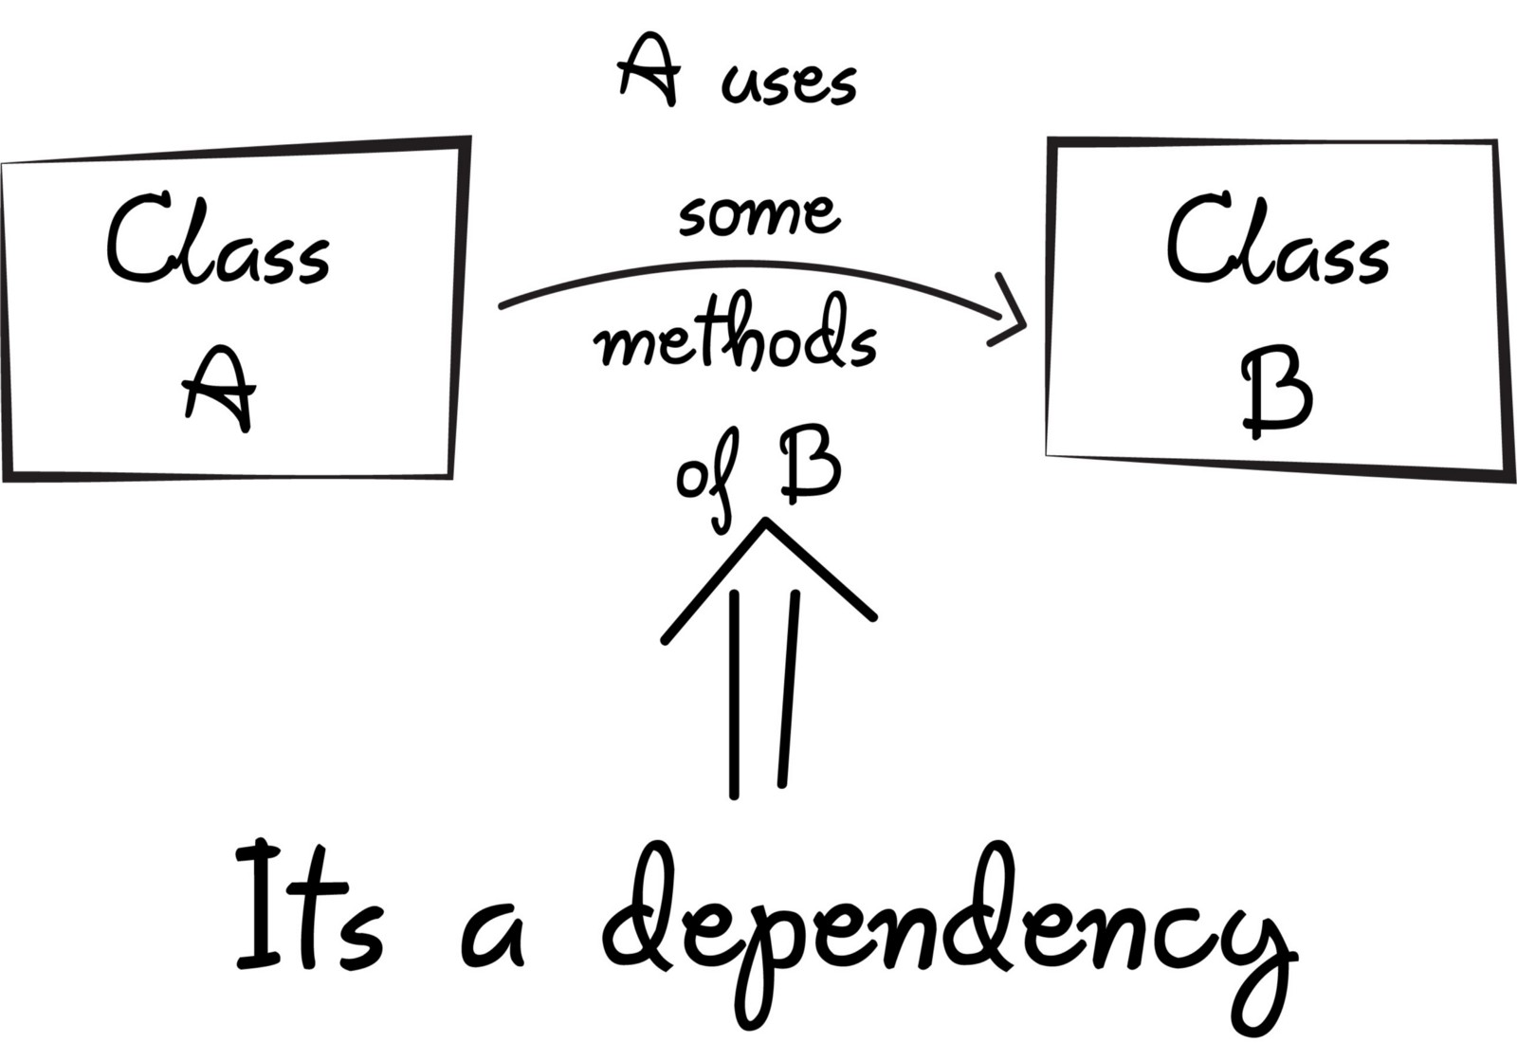
Dependency injection

Slide 82
Dependency injection
Create an injectable service class
ng generate service heroes/hero
Using decorator @Injectable
Configure an injector with a service provider
In the @Injectable() decorator for the service itself.
In the @NgModule() decorator for an NgModule.
In the @Component() decorator for a component.
Injecting services
Tell Angular to inject a dependency in a component's constructor by specifying a constructor parameter with the dependency type

Slide 83
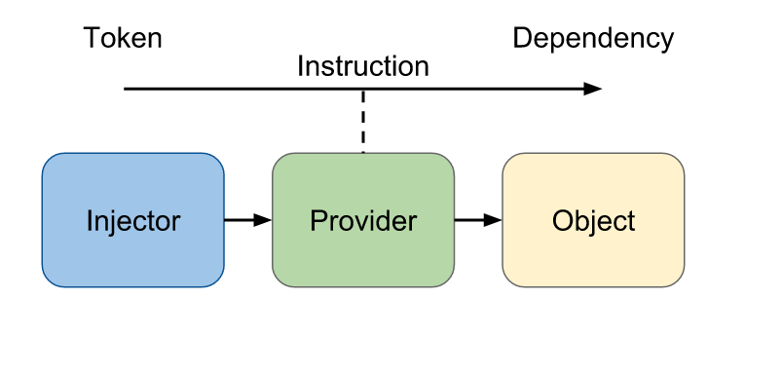
Dependency injection
Injector: là một object có chứa các API để chúng ta tạo các instances của các phụ thuộc.
Provider: giống như một công thức để Injector có thể biết làm thế nào để tạo một instance của một phụ thuộc.
Dependency: là một object của một kiểu dữ liệu cần phải khởi tạo.

Slide 84
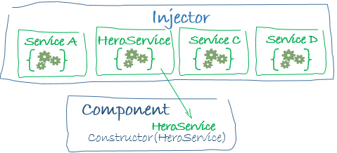
Dependency injection
Dependency providers
A dependency provider configures an injector with a DI token, which that injector uses to provide the concrete, runtime version of a dependency value.
The injector relies on the provider configuration to create instances of the dependencies that it injects into components, directives, pipes, and other services.

Slide 85
Dependency injection
The Provider object literal
[{ provide: Logger, useClass: Logger }]
Alternative class providers
[{ provide: Logger, useClass: BetterLogger }]
[ NewLogger,
{ provide: OldLogger, useExisting: NewLogger}]
Non-class dependencies
inject a string, function, or object.
use an InjectionToken
Ex: export const APP_CONFIG = new InjectionToken<AppConfig>('app.config');
providers: [{ provide: APP_CONFIG, useValue: HERO_DI_CONFIG }]

Slide 86
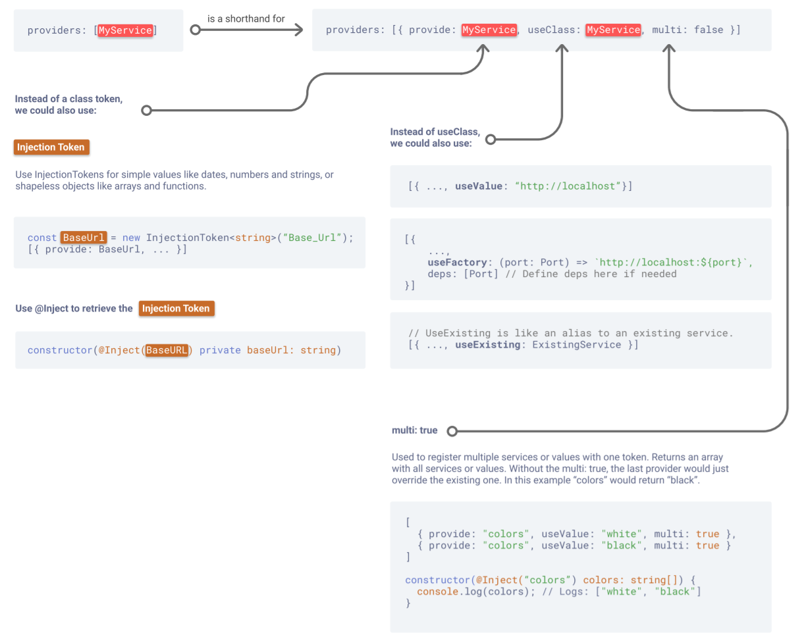
Dependency injection

Slide 87
Dependency injection
Tree-shakable providers
providedIn: 'root',
-> Singleton

Slide 88
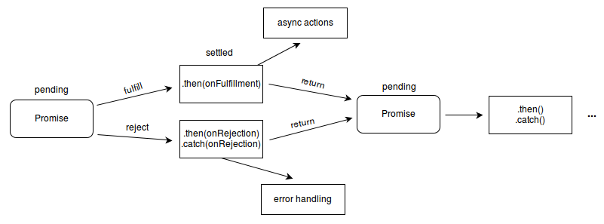
Promise (Javascript)
Lets asynchronous methods return values like synchronous methods: instead of immediately returning the final value, the asynchronous method returns a promise to supply the value at some point in the future.
https://www.w3schools.com/js/js_promise.asp
https://topdev.vn/blog/tat-tan-tat-ve-promise-va-asyncawait

Slide 89
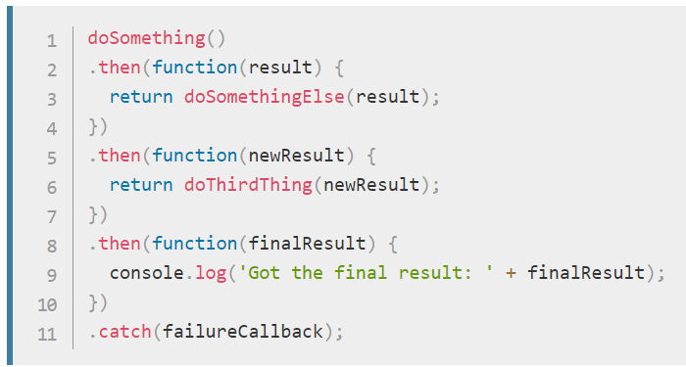
Promise (Javascript)
Ex
const promise = createAudioFileAsync(audioSettings); promise.then(successCallback, failureCallback)
Chaining

Slide 90
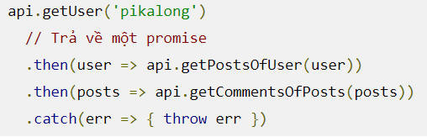
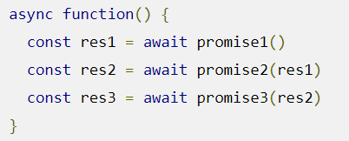
Promise (Javascript)

Slide 91
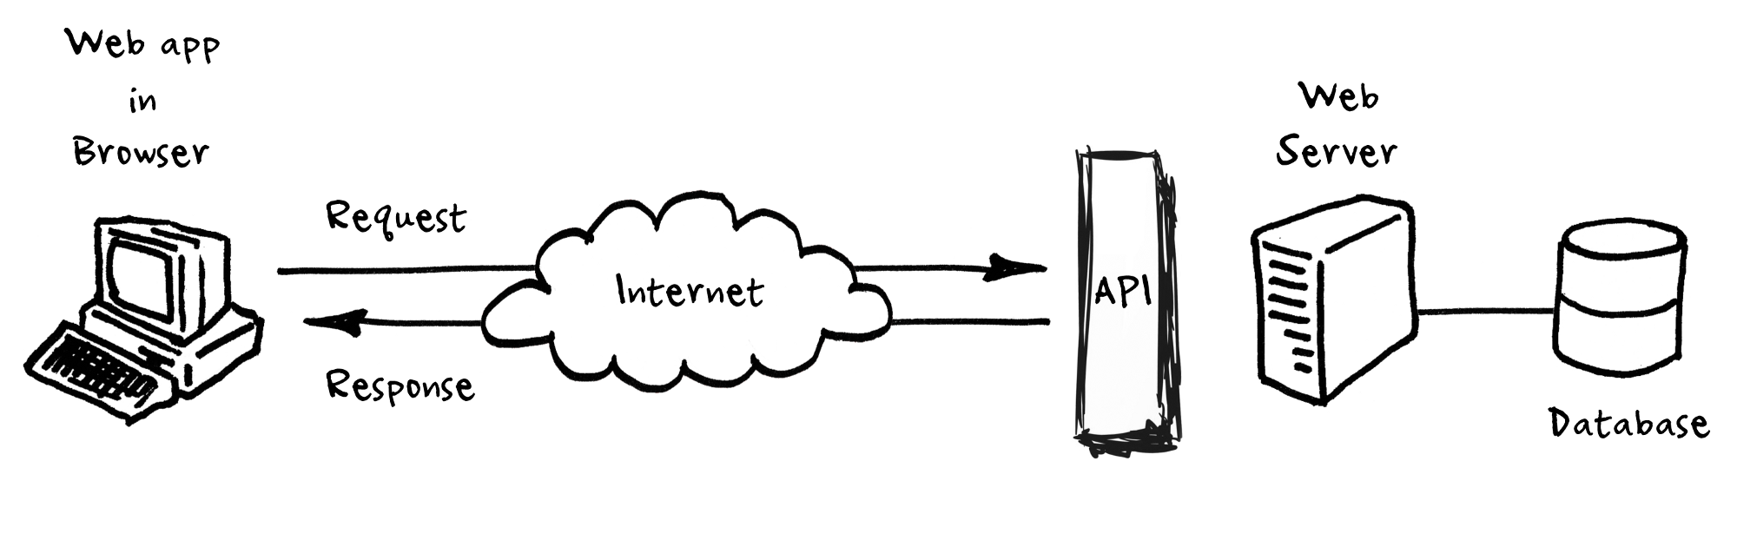
Http Client
https://angular.io/guide/http
Most front-end applications need to communicate with a server over the HTTP protocol, to download or upload data and access other back-end services.
HttpClient class in @angular/common/http.

Slide 92
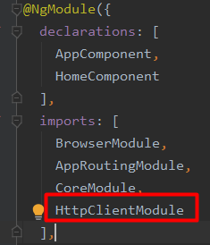
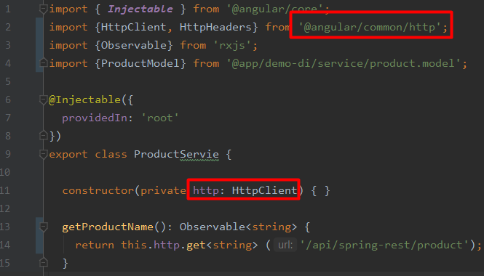
Http Client
Setup for server communication
Import the Angular HttpClientModule
Inject the HttpClient service as a dependency of an application class
Using RxJS observable and operator symbols

Slide 93
Http Client
Requesting data from a server
The aynchronous method sends an HTTP request, and returns an Observable that emits the requested data when the response is received
Example: get() method takes two arguments:
endpoint URL
options object

Slide 94
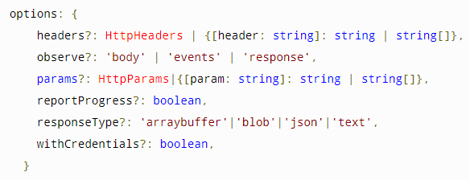
Http Client
The observe option specifies how much of the response to return.
The responseType option specifies the format in which to return data.

Slide 95
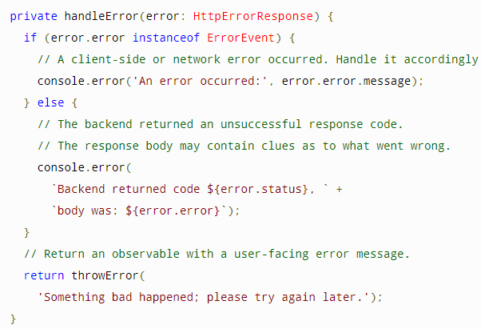
Http Client
Handling request errors
The handler returns an RxJS ErrorObservable with a user-friendly error message
Using a pipe to send all observables returned by the HttpClient.get() call to the error handler.
return this.http.get<Config>(this.configUrl) .pipe( catchError(this.handleError) );

Slide 96

Http Client
Retrying a failed request
The RxJS library offers several retry operators.
For example, the retry() operator automatically re-subscribes to a failed Observable a specified number of times.

Slide 97

Http Client
Other methods
HttpClient supports other HTTP methods such as PUT, POST, and DELETE

Slide 98

Http Client
Configuring HTTP URL parameters
Use the HttpParams class with the params request option to add URL query strings in your HttpRequest.
import {HttpParams} from "@angular/common/http";
const paramHeres = new HttpParams({fromString: 'name=foo'});
const options = { params: paramHere}

Slide 99
Http Client
Intercepting requests and responses
Interceptors can perform a variety of implicit tasks, from authentication to logging, in a routine, standard way, for every HTTP request/response.
Without interception, developers would have to implement these tasks explicitly for each HttpClient method call.

Slide 100
Http Client
Write an interceptor
Declare a class that implements the intercept() method of the HttpInterceptor interface.
Provide interceptors in AppModule
{ provide: HTTP_INTERCEPTORS, useClass: NoopInterceptor, multi: true },
Most interceptors call next.handle() so that the request flows through to the next interceptor and, eventually, the backend handler.

Slide 101

Http Client
Example
Adds an authorization header with that token to every outgoing request

Slide 102

Http Client

Slide 103

Routing & Navigation
https://angular.io/guide/router
You change what the user sees by showing or hiding portions of the display that correspond to particular components.

Slide 104


Routing & Navigation
Defining a basic route
Import the AppRoutingModule into AppModule and add it to the imports array.
Import RouterModule and Routes into your routing module.
Define your routes in your Routes array.
Add your routes to your application.
<a routerLink="/first-component" routerLinkActive="active">First Component</a>

Slide 105



Routing & Navigation
Setting up wildcard routes
Ex: Displaying a 404 page
{ path: '**', component: PageNotFoundComponent }, // Wildcard route for a 404 page
Nesting routes
The router outlet serves as a placeholder where the routed components are rendered.

Slide 106


Routing & Navigation
Lazy loading
ng generate guard your-guard
Use route guards to prevent users from navigating to parts of an app without authorization. The following route guards
CanActivate
CanActivateChild
CanDeactivate
Resolve
CanLoad

Slide 107

Routing & Navigation
Router outlet
It acts as a placeholder that marks the spot in the template where the router should display the components for that outlet.

Slide 108

Routing & Navigation

Slide 109
Libs
https://ng-bootstrap.github.io/#/components/modal/examples
https://ng-bootstrap.github.io/#/components/alert/examples

Slide 110
Observables & RxJS

Slide 111
Observables & RxJS
https://rxjs-dev.firebaseapp.com/guide/observable
https://www.learnrxjs.io/
http://reactivex.io/documentation/observable.html
https://developer.mozilla.org/vi/docs/Web/JavaScript/Reference/Statements/async_function
https://techtalk.vn/chon-promise-hay-observable-khi-lam-viec-voi-angular.html

Slide 112
Observables & RxJS
Define a function for publishing values, but it is not executed until a consumer subscribes to it.
The subscribed consumer then receives notifications until the function completes, or until they unsubscribe.
An Observable is a lazily evaluated computation that can synchronously or asynchronously return zero to (potentially) infinite values from the time it's invoked onwards.
A Function is a lazily evaluated computation that synchronously returns a single value on invocation.

Slide 113



Slide 114

Observables & RxJS

Slide 115



Slide 116
onNext
An Observable calls this method whenever the Observable emits an item. This method takes as a parameter the item emitted by the Observable.
onError
An Observable calls this method to indicate that it has failed to generate the expected data or has encountered some other error. It will not make further calls to onNext or onCompleted. The onError method takes as its parameter an indication of what caused the error.
onCompleted
An Observable calls this method after it has called onNext for the final time, if it has not encountered any errors.

Slide 117


What is the difference between an Observable and a function?
Observables can "return" multiple values over time, something which functions cannot.

Slide 118
func.call() means "give me one value synchronously"
observable.subscribe() means "give me any amount of values, either synchronously or asynchronously"

Slide 119
Anatomy
Creating Observables
The Observable constructor takes one argument: the subscribe function.
Most commonly, observables are created using creation functions, like of, from, interval, etc.
Subscribing to Observables
Subscribing to an Observable is like calling a function, providing callbacks where the data will be delivered to.
Executing Observables
next*(error|complete)?
Disposing Observable Executions
subscription.unsubscribe();

Slide 120


Slide 121

Example for filter

Slide 122
Subject
A special type of Observable that allows values to be multicasted to many Observers.
Every Subject is an Observable. Given a Subject, you can subscribe to it, providing an Observer, which will start receiving values normally.
Every Subject is an Observer. It is an object with the methods next(v), error(e), and complete().

Slide 123


Slide 124





